Slide 1
Hybrid Karatsuba Multiplication
20.04.19
https://youtu.be/AOscc-hPd4Q

Slide 2
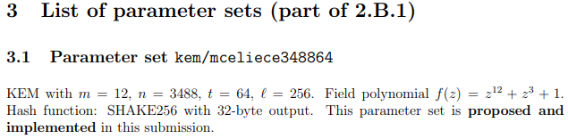
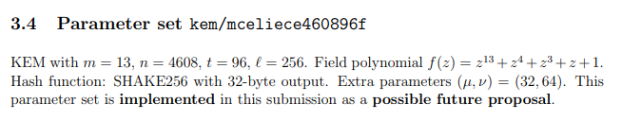
Karatsuba

Slide 3
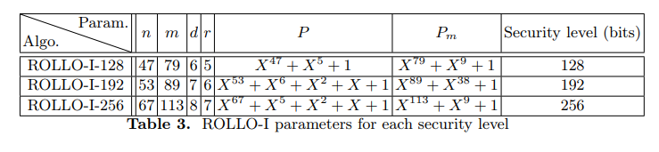
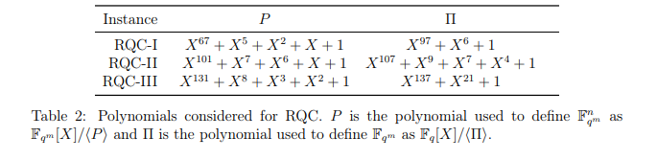
Karatsuba

Slide 4
Karatsuba 2-way
(h₀+a₀) + (h₁+a₀+a₁+b₀+r₀)x^{k} + (h₂+a₁+b₀+b₁+r₁)x^{2k} + (h₃+b₁)x^{3k}
a₀
a₀
a₁
b₀
r₀
a₁
b₀
b₁
r₁
b₁
a[i]
b[i]
f₀
g₁
f₁
g₁
r = (f₀ + f₁) * (g₀ + g₁)
alpah beta

Slide 5

Karatsuba 3-way
r_{c}
r_{b}
r_{a}

Slide 6
Karatsuba 3-way
0 k 2k 3k 4k 5k
a b c
a b c
a b c
r_{a} r_{b} r_{c}

Slide 7
Karatsuba 2-bit
0 k 2k
a₀
a₁
b₀
r
b₁
0 k 2k
0
0
1
1
1
r = (f₀ + f₁) * (g₀ + g₁)
f₁ f₀
10
10
100
a = 1 0
b = 1 0
r = (1 + 0) * (1 + 0) = 1
r = (1 + 0) * (1 + 0) = 1
g₁ g₀
beta
alpha

Slide 8
Karatsuba 2-way & 3-way
0 k 2k 3k
a₀
a₀
a₁
b₀
r₀
a₁
b₀
b₁
r₁
b₁
0 k 2k 3k 4k 5k
a b c
a b c
a b c
r_{a} r_{b} r_{c}

Slide 9
Hybrid Karatsuba on 13
13
2 way
6
7
3 way
7~12
0~6
2 way
2
2
2
3
4
2 way
2 way
1
1
1
1
1
1
1 1 1
2
2
2 way
3 way
1
1
1
1

Slide 10
Hybrid Karatsuba on 13
13
2 way
13
6
7
a₀
a₁
b₀
b₁
beta
alpha
2
2
2
3
4
1
1
1
1
1
1
1 1 1
2
2
3 way
a
b
c
1
1
1
1

Slide 11
Hybrid Karatsuba on 13
13
13 | C_{0~6} | C_{7~13} | C_{14~20} | C_{21~24}
13 x 2 - 1 → 25 | a0 | a1
13 / 2 = 6.5 → 7 |  | b0 |  | b1
6
7
3
4
2
2
7 | C_{0~3} | C_{4~7} | C_{8~11} | C₁₂
7 x 2 - 1 → 13 | a0 | a1
7 / 2 = 3.5 → 4 |  | b0 |  | b1
13의 a₀ a₁
1
1
1
1
4 | C_{0~1} | C_{2~3} | C_{4~5} | C₆
4 x 2 - 1 → 7 | a0 | a1
4 / 2 = 2 |  | b0 |  | b1
7의 a₀ a₁
2 | C₀ | C₁ | C₂
2 x 2 - 1 → 3 | a0 | a1
2 / 2 = 1 |  | b0 | b1
2 | C₂ | C₃ | C₆
2 x 2 - 1 → 3 | a0 | a1
2 / 2 = 1 |  | b0 | b1

Slide 12
Hybrid Karatsuba on 13
13
13 | C_{0~6} | C_{7~13} | C_{14~20} | C_{21~24}
13 x 2 - 1 → 25 | a0 | a1
13 / 2 = 6.5 → 7 |  | b0 |  | b1
6
7
3
4
7 | C_{0~3} | C_{4~7} | C_{8~11} | C₁₂
7 x 2 - 1 → 13 | a0 | a1
7 / 2 = 3.5 → 4 |  | b0 |  | b1
13의 a₀ a₁
1 1 1
2
2
1
1
1
1
4 | C_{0~1} | C_{2~3} | C_{4~5} | C₆
4 x 2 - 1 → 7 | a0 | a1
4 / 2 = 2 |  | b0 |  | b1
7의 a₀ a₁
3 | C₄ | C₅ | C₆ | C₇ | C₁₂
3 x 2 - 1 → 5 |  | A
3 / 2 = 1.5 → 2 |  |  |  | B
 |  |  |  |  | C
7의 b₀ b₁

Slide 13
Hybrid Karatsuba on 13
13
C₀ | C₁ | C₂ | C₃ | C₄ | C₅ | C₆
a0 | a0 | a1 | a1
 |  | b0 | b0 |  |  | b1
6
7
3
4
1 1 1
2
2
1
1
1
1
 | C₄ | C₅ | C₆ | C₇ | C₁₂
 |  | A
 |  |  |  | B
 |  |  |  |  | C

Slide 14
Hybrid Karatsuba on 13
13
C₀ | C₁ | C₂ | C₃ | C₄ | C₅ | C₆
a0 | a0 | a1 | a1 | a1 | A1
 |  | b0 | b0 | b0 | b0 | b1
 |  | a0 | a0 | b1
6
7
3
4
1 1 1
2
2
1
1
1
1
 | C₄ | C₅ | C₆ | C₇ | C₁₂
 | A | B | C
 |  | A | B | C
 |  |  | A | B | C

Slide 15
Hybrid Karatsuba on 13
13
C₀ | C₁ | C₂ | C₃ | C₄ | C₅ | C₆
a0 | a0 | a1 | a1 | a1 | A1
 |  | b0 | b0 | b0 | b0 | b1
 |  | a0 | a0 | b1
6
7
3
4
1 1 1
2
2
1
1
1
1
 | C₄ | C₅ | C₆ | C₇ | C₁₂
 | A | B | C
 |  | A | B | C
 |  |  | A | B | C
https://www.youtube.com/watch?v=m9VMjSfl3mA
12:40 → 순서 설명

Slide 16
Hybrid Karatsuba on 13
13
13 | C_{0~6} | C_{7~13} | C_{14~20} | C_{21~24}
13 x 2 - 1 → 25 | a0 | a1
13 / 2 = 6.5 → 7 |  | b0 |  | b1
6
7
3
4
7 | C_{0~3} | C_{4~7} | C_{8~11} | C₁₂
7 x 2 - 1 → 13 | a0 | a1
7 / 2 = 3.5 → 4 |  | b0 |  | b1
13의 a₀ a₁
1 1 1
2
2
1
1
1
1

Slide 17
Hybrid Karatsuba on 13
13
13 | C_{0~6} | C_{7~13} | C_{14~20} | C_{21~24}
13 x 2 - 1 → 25 | a0 | a1
13 / 2 = 6.5 → 7 |  | b0 |  | b1
6
7
2 2 2
3
4
7 | C_{0~3} | C_{4~7} | C_{8~11} | C₁₂
7 x 2 - 1 → 13 | a0 | a1
7 / 2 = 3.5 → 4 |  | b0 |  | b1
13의 a₀ a₁
1
1
1
1
1
1
1 1 1
2
2
1
1
1
1

Slide 18
Hybrid Karatsuba on 13
13 | C_{0~6} | C_{7~13} | C_{14~20} | C_{21~24}
13 x 2 - 1 → 25 | a0 | a1
13 / 2 = 6.5 → 7 |  | b0 |  | b1
13
6
7
2 2 2
3
4
7 | C_{0~3} | C_{4~7} | C_{8~11} | C₁₂
7 x 2 - 1 → 13 | a0 | a1
7 / 2 = 3.5 → 4 |  | b0 |  | b1
13의 a₀ a₁
1
1
1
1
1
1
1 1 1
2
2
1
1
1
1
6 | C_{7~8} | C_{9~10} | C_{11~12} | C_{13,21} | C_{22,23} | C₂₄
6 x 2 - 1 → 11 |  | a |  | a1
6 / 2 = 3 |  |  |  | b0 | B1
 |  |  |  |  | c0 | c1
a[i]
b[i]
2 | C₉ | C₁₀ | C₁₃
 | a0 | a1
 |  | b0 | b1
2 | C₁₃ | C₂₁ | C₂₂
 | a0 | a1
 |  | b0 | b1
2 | C₉ | C₁₀ | C₁₃
 | a0 | a1
 |  | b0 | b1

Slide 19
Hybrid Karatsuba on 13
13 | C_{0~6} | C_{7~13} | C_{14~20} | C_{21~24}
13 x 2 - 1 → 25 | a0 | a1
13 / 2 = 6.5 → 7 |  | b0 |  | b1
13
6
7
2 2 2
3
4
7 | C_{0~3} | C_{4~7} | C_{8~11} | C₁₂
7 x 2 - 1 → 13 | a0 | a1
7 / 2 = 3.5 → 4 |  | b0 |  | b1
13의 a₀ a₁
1
1
1
1
1
1
1 1 1
2
2
1
1
1
1
6 | C_{7~8} | C_{9~10} | C_{11~12} | C_{13,21} | C_{22,23} | C₂₄
6 x 2 - 1 → 11 |  | a |  | a1
6 / 2 = 3 |  |  |  | b0 | B1
 |  |  |  |  | c0 | c1
C₇ | C₈ | C₉ | C₁₀ | C₁₁ | C₁₂ | C₁₃ | C₂₁ | C₂₂ | C₂₃ | C₂₄
 |  | a0 | a0 |  |  | a1
 |  |  |  |  |  | b0 | b0 | b1
 |  |  |  |  |  |  |  | c0 | c0 | c1
https://www.youtube.com/watch?v=m9VMjSfl3mA
16:40 → 순서 설명

Slide 20
Hybrid Karatsuba on 13
13
6
7
13 | C_{0~6} | C_{7~13} | C_{14~20} | C_{21~24}
13 x 2 - 1 → 25 | a0 | a1
13 / 2 = 6.5 → 7 |  | b0 |  | b1
2 2 2
3
4
1
1
1
1
1
1
1 1 1
2
2
1
1
1
1
7 | C_{0~3} | C_{4~7} | C_{8~11} | C₁₂
7 x 2 - 1 → 13 | a0 | a1
7 / 2 = 3.5 → 4 |  | b0 |  | b1
6 | C_{7~8} | C_{9~10} | C_{11~12} | C_{13,21} | C_{22,23} | C₂₄
6 x 2 - 1 → 11 |  | a0 |  | a1
6 / 2 = 3 |  |  |  | b0 | b1
 |  |  |  |  | c0 | c1

Slide 21
Hybrid Karatsuba on 13
13
6
7
13 | C_{0~6} | C_{7~13} | C_{14~20} | C_{21~24}
13 x 2 - 1 → 25 | a0 | a1
13 / 2 = 6.5 → 7 |  | b0 |  | b1
2 2 2
3
4
1
1
1
1
1
1
1 1 1
2
2
1
1
1
1
COPY
a₀
a₀
a₁
b₀
r₀
a₁
b₀
b₁
r₁
b₁

Slide 22
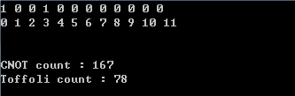

Hybrid Karatsuba

Slide 23
Hybrid Karatsuba
Hybrid
2 Way only
 | 12 | 13
Gate | 47 | 51
CNOT | 167 | 210
Toffoli | 78 | 102
 | 12 | 13
Gate | 47 | 51
CNOT | 66 | 97
Toffoli | 108 | 134
CNOT : Hybrid > 2 Way (100~110 average)
Toffoli : Hybird < 2 Way (30 average)
1 gate 9개 + CNOT 6개

